Slide 1


Music Player Using Tkinter

Slide 2
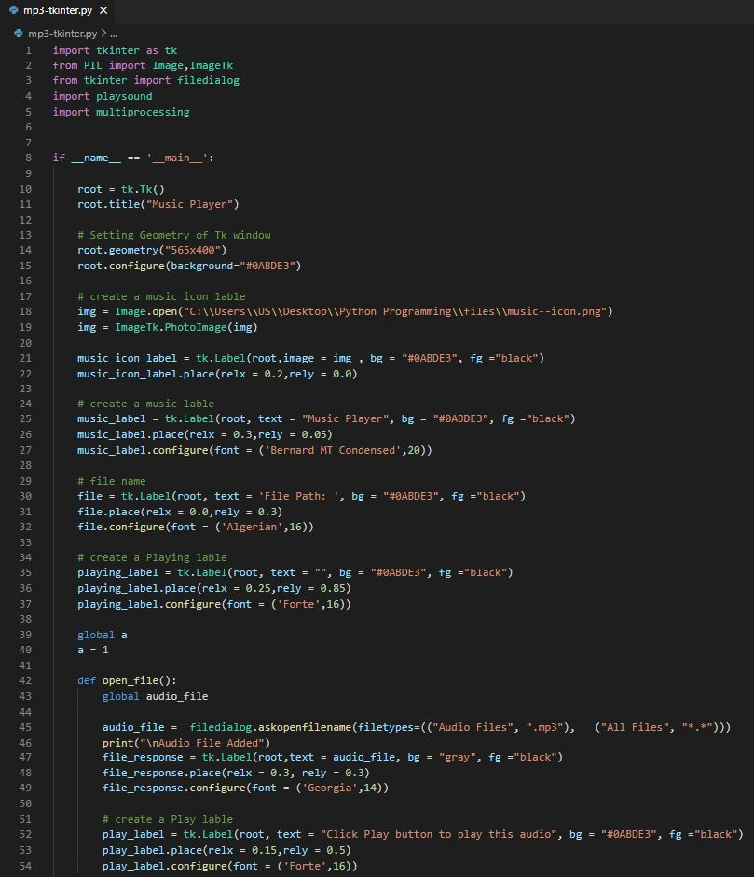
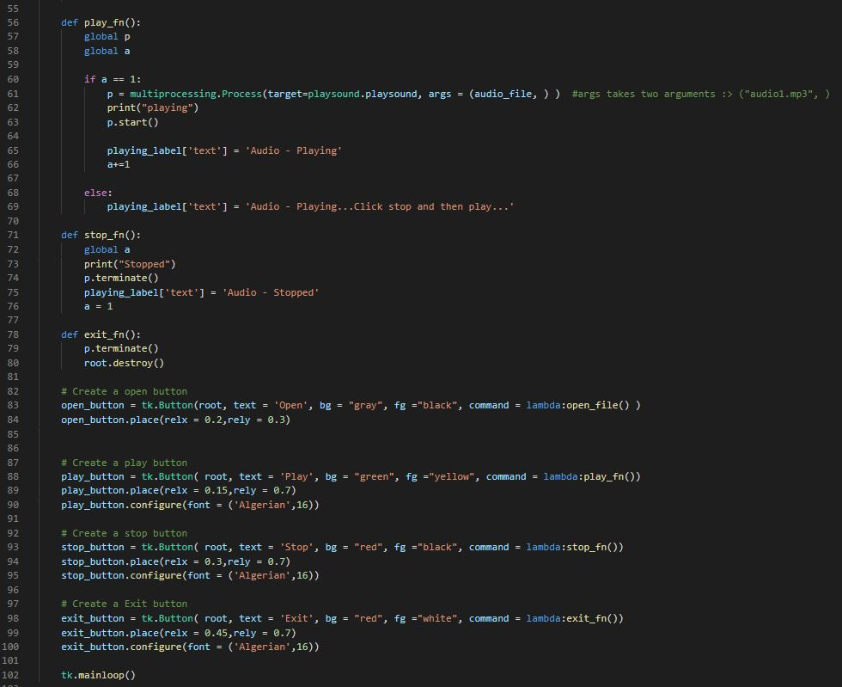
Python Snippet

Slide 3
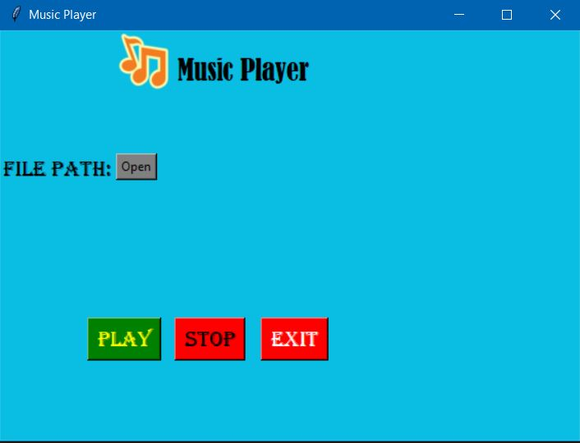
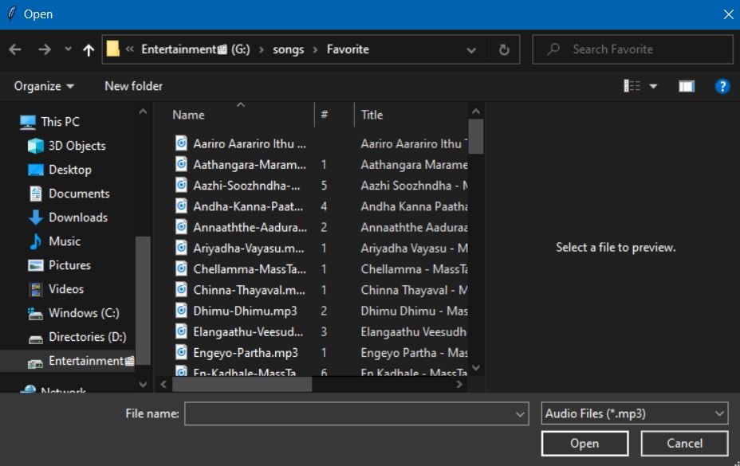
Output
from PIL import Image,ImageTk
--> For music icon < Line No : 18,19 >
mainloop() < Line No : 42 >
Open_file() < Line No : 42 >
Open button < Line No : 82 >
import tkinter
from tkinter import filedialog
filedialog.askopenfilename
<Line No : 45>

Slide 4
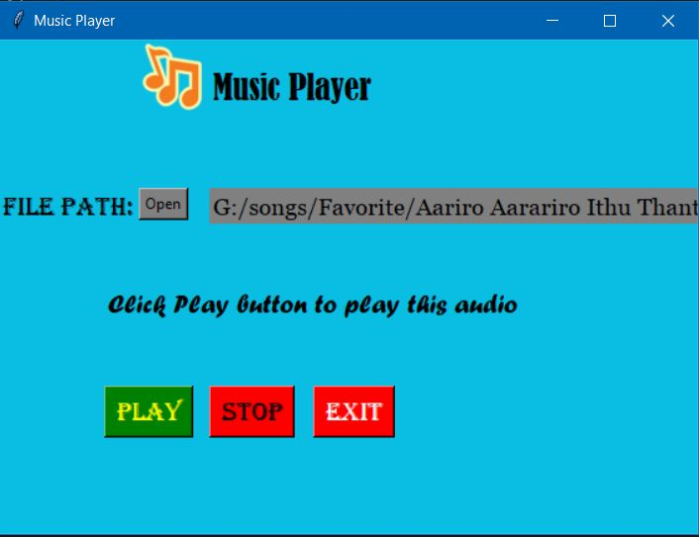
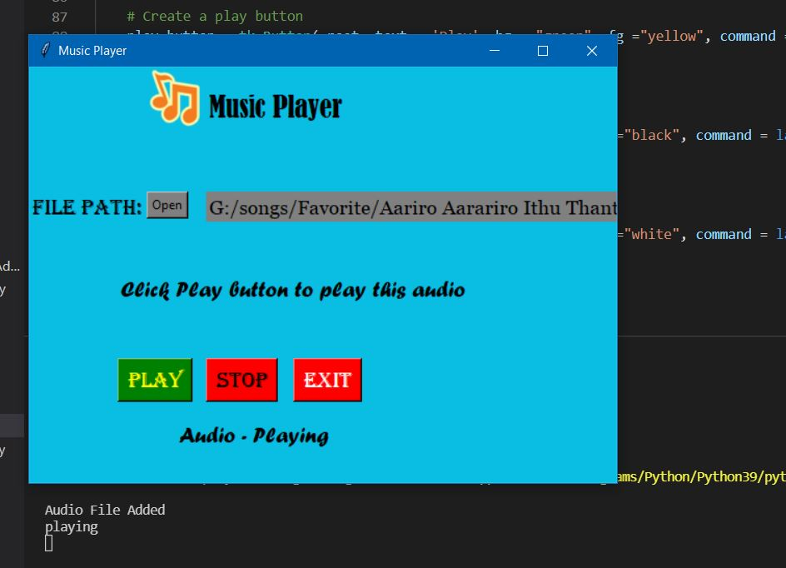
open_file() < Line No : 47, 52 >
play_fn() < Line No : 56 >
Play button < Line No : 87 >
import multiprocessing
import playsound
--> For start process < Line No : 61, 63 >
--> For Playing audio < Line No : 61 >

Slide 5
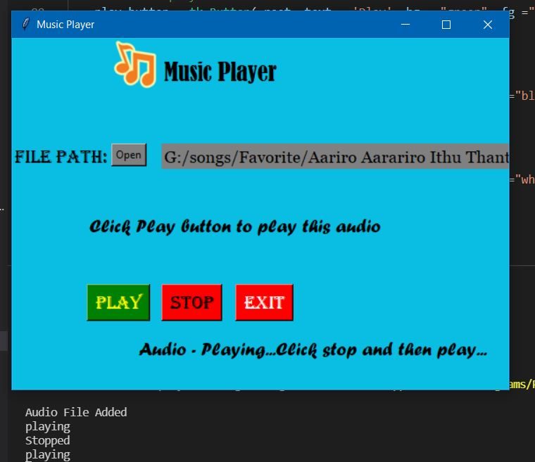
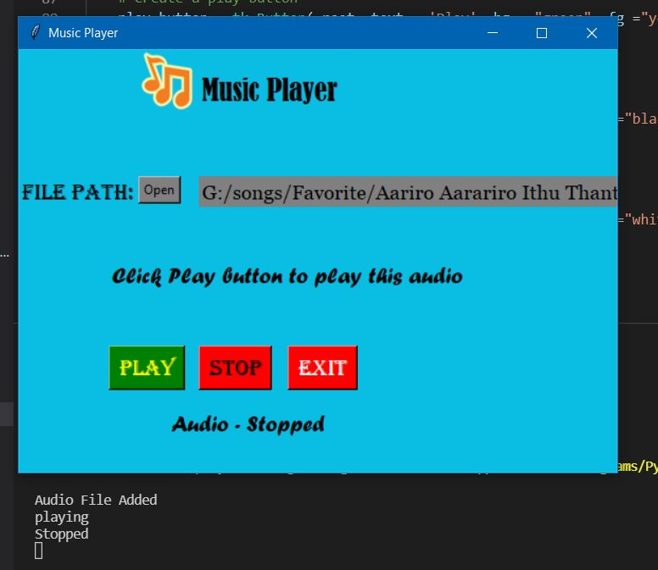
Click Play button again < Line No : 69 >
stop_fn() < Line No : 71 >
Stop button < Line No : 92 >
import multiprocessing
--> For Terminate process
< Line No : 74 >
exit_fn() < Line No : 78 >
Exit button < Line No : 97 >

